Slide 1

The AI Data Science Agent Mix
Cursor for Data Scientists

Slide 2

AI Data Science Agent Mix
Cursor for Data Scientists
Good morning. Every developer today is getting an AI copilot that writes code. But what about data scientists? Their workflow is far more complex than just writing code. It's about a process. Today, we're introducing the copilot for that entire process. We call it the AI Data Science Agent Mix: the Cursor for Data Scientists.

Slide 3

The Problem: The Data Science Bottleneck
80% Time on Cleaning
Data scientists spend a vast majority of their time on data preparation and cleaning, not on analysis.
Repetitive EDA
Exploratory Data Analysis often involves tedious, repeatable tasks that consume valuable time.
Tool-Switching Chaos
The need to constantly switch between various tools and platforms fragments the workflow.
Deployment Friction
Bringing models into production is often complex, slow, and prone to errors.

Slide 4
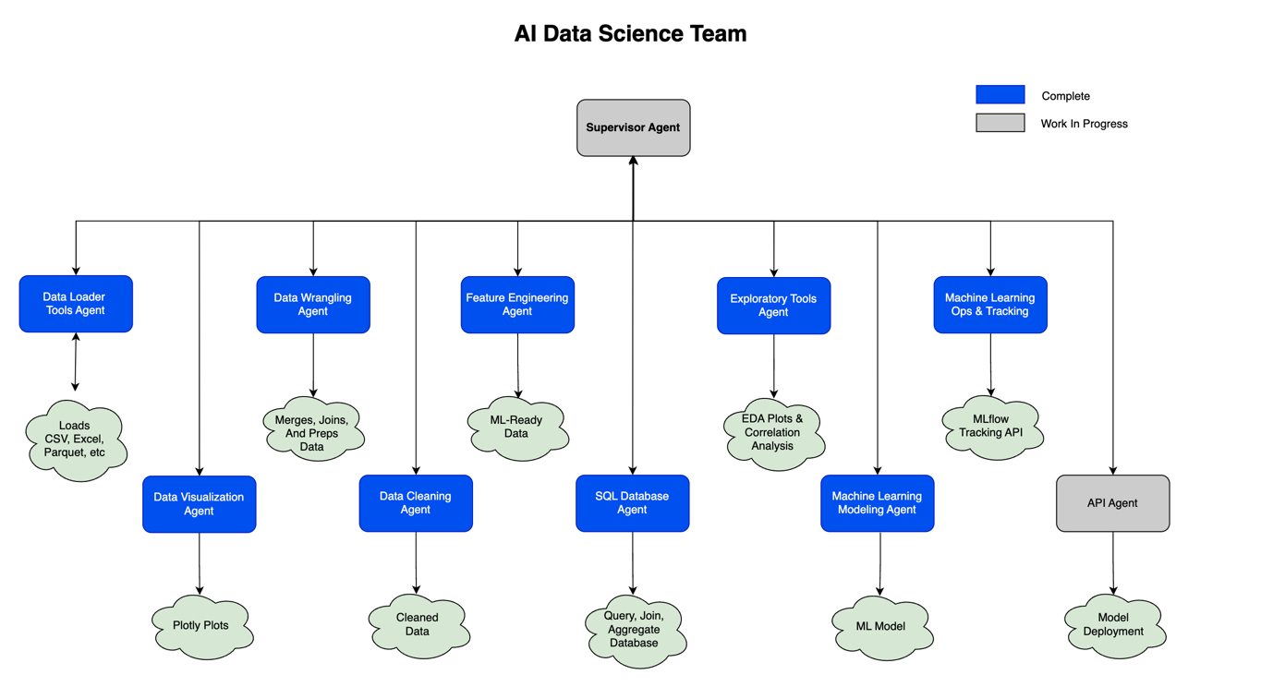
The Solution: Your AI Data Science Team

Slide 5
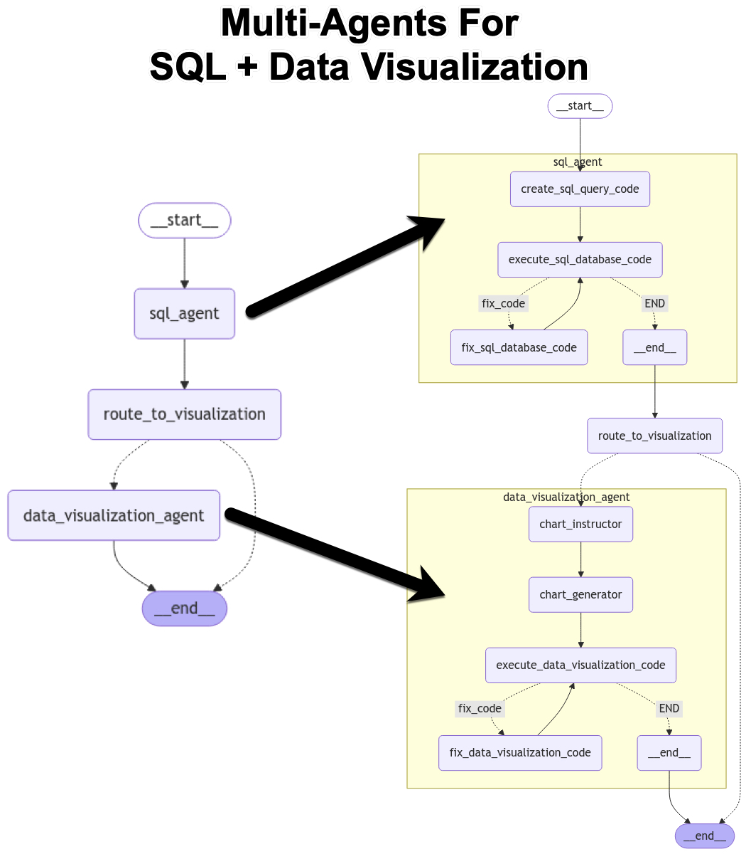
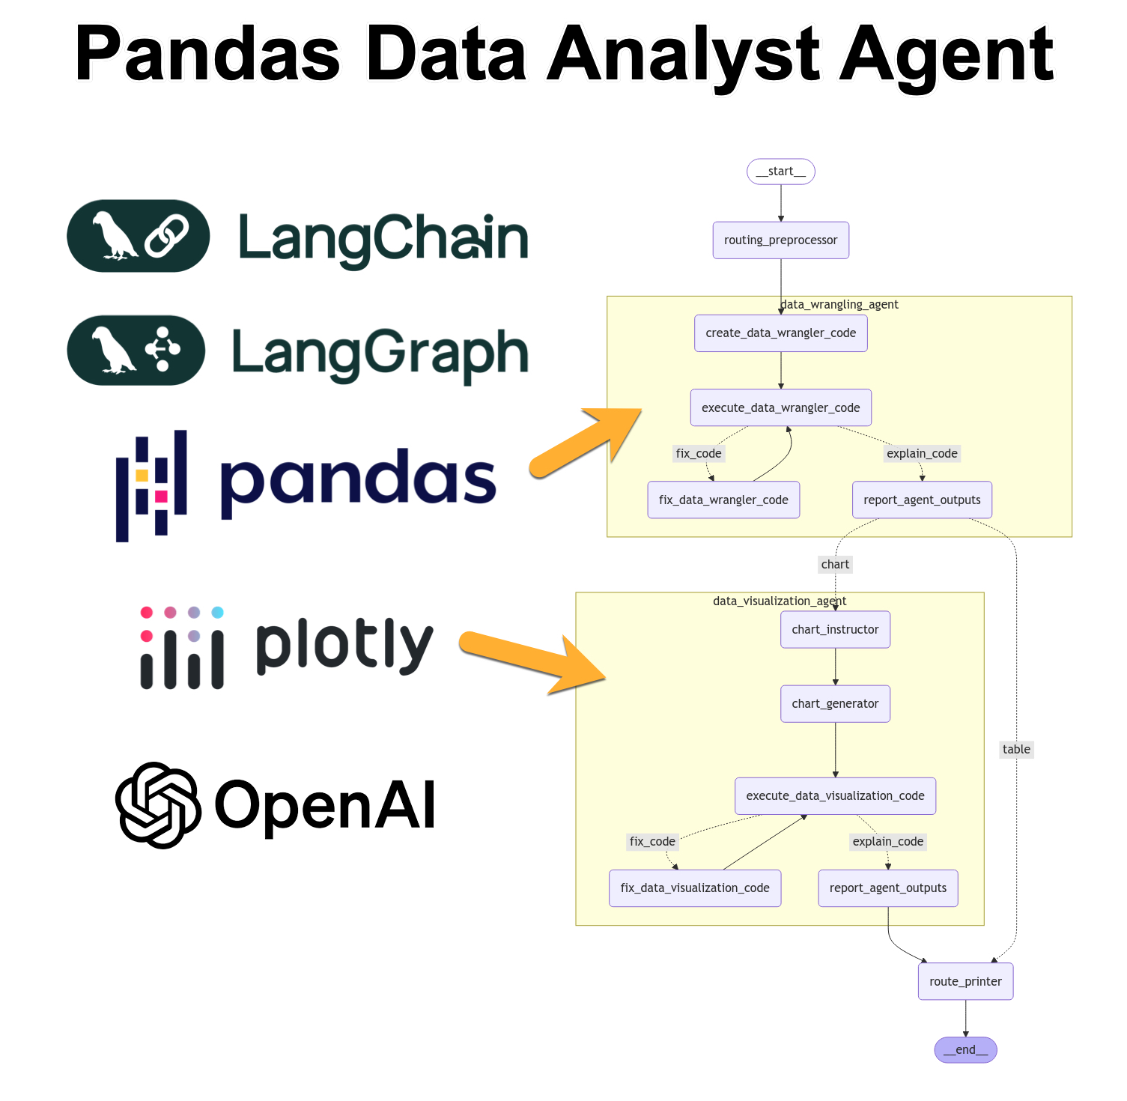
How It Works: From Prompt to Insight
So how does it work? It's powered by an agentic graph. When you enter a prompt, the Supervisor routes it to the right agent. For example, our Pandas Analyst. This agent doesn't just write code; it creates a plan, executes it, and—critically—if the code fails, it enters a self-correction loop to fix it. This resilience is what makes it so powerful.

Slide 6
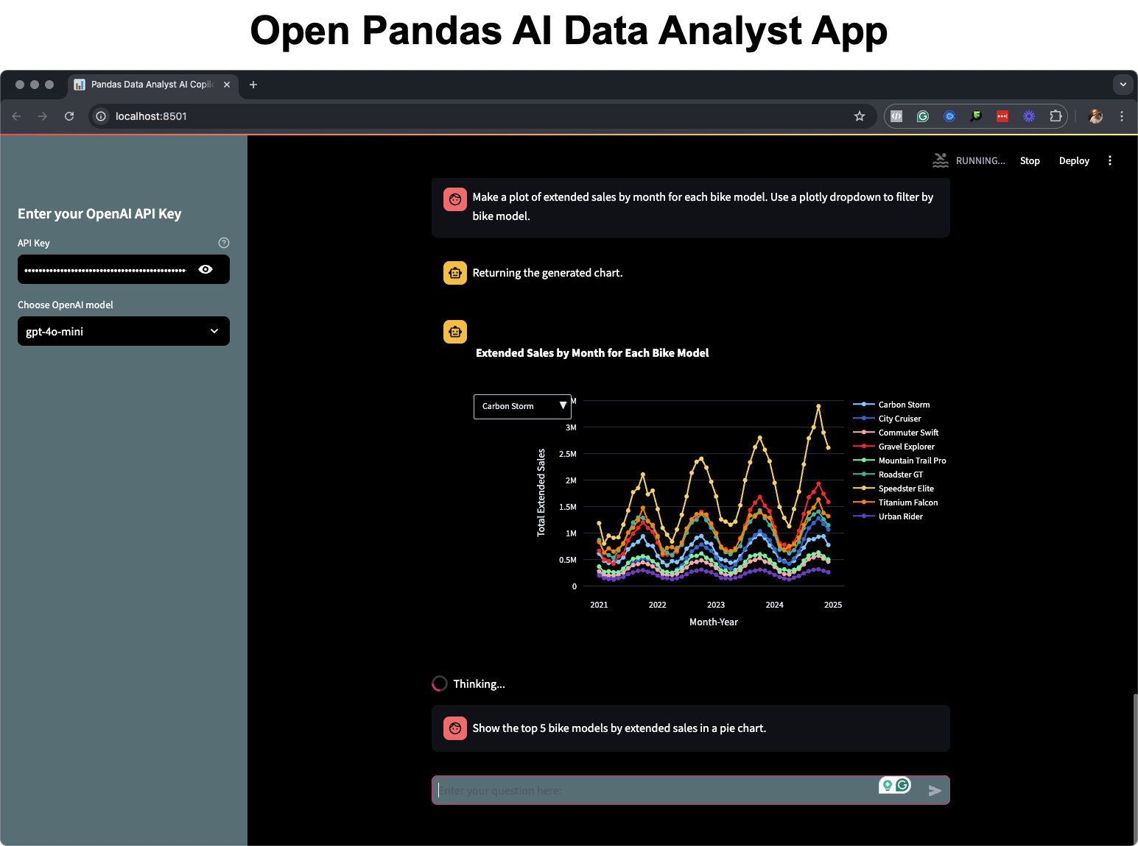
DEMO 1: The Analyst Copilot in Action

Slide 7
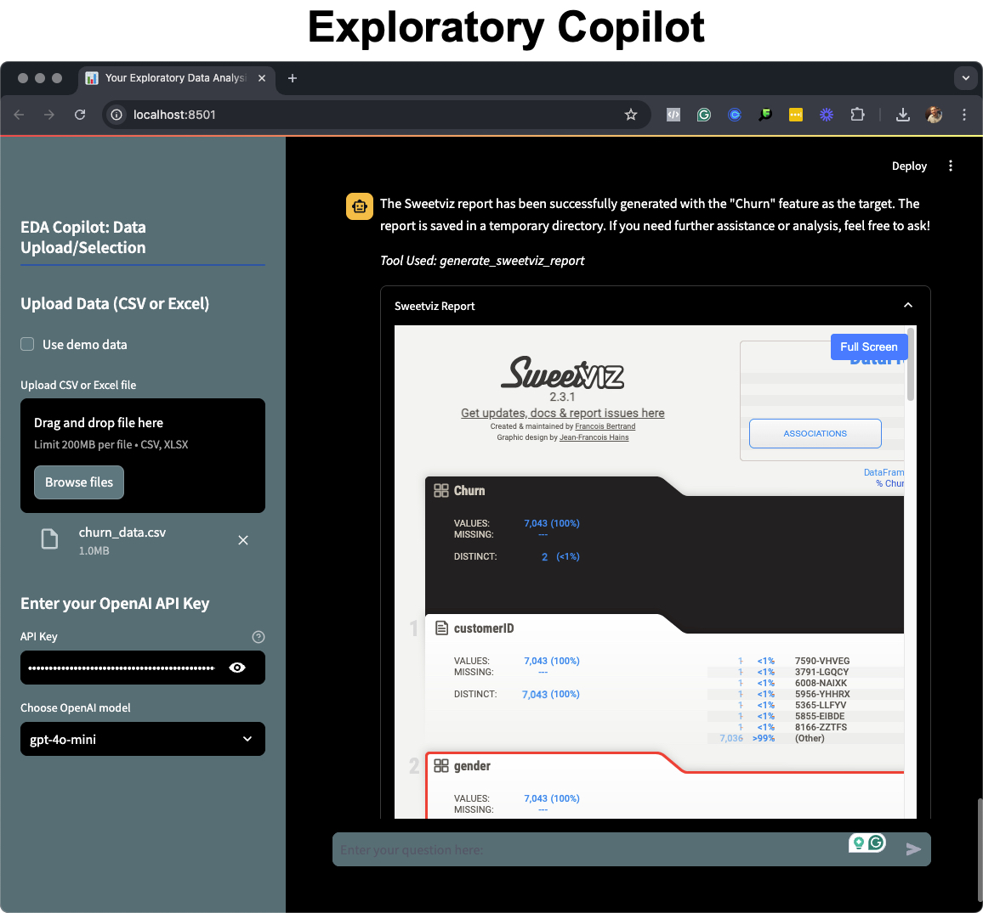
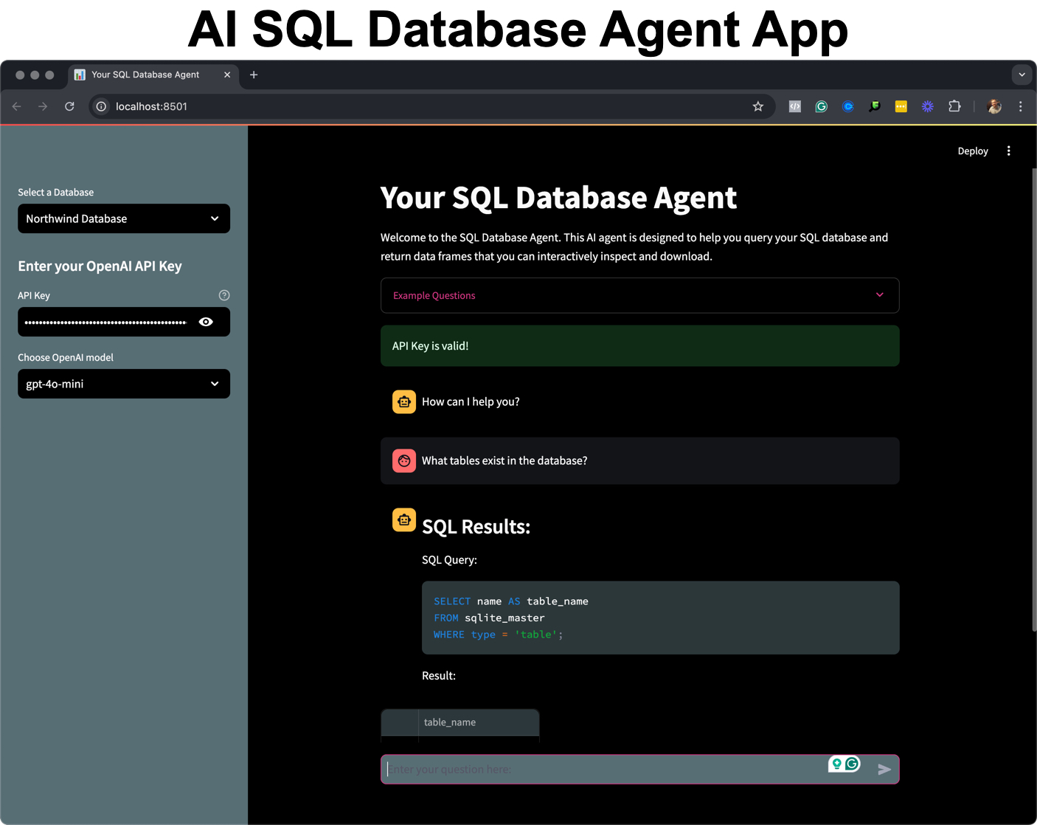
DEMO 2: Beyond Files - Databases & Automated EDA
Our SQL Agent connects directly to your database, allowing natural language queries to generate and run complex SQL statements.
Our Exploratory Copilot automates comprehensive EDA, generating insights into data quality and correlations with a single click.

Slide 8
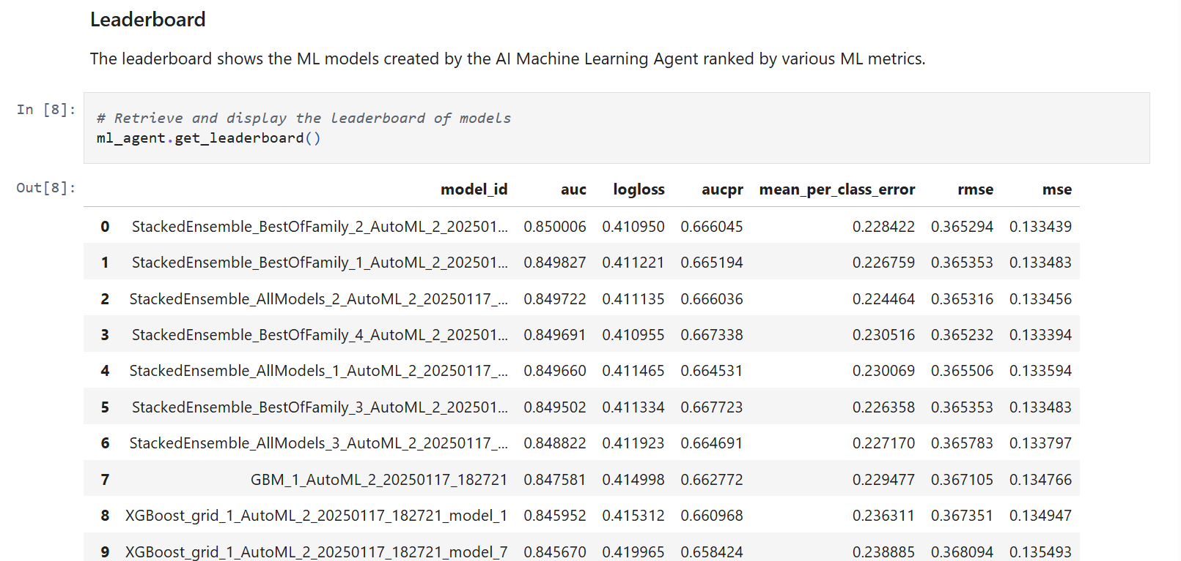
DEMO 3: From Analysis to Advanced Modeling
Our Machine Learning Agent automates training, tuning, and comparison of dozens of models for specific problems like churn prediction.

Slide 9
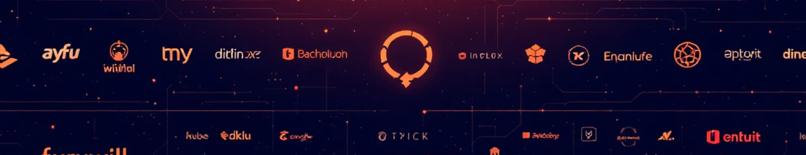
The Tech Stack: Built on a Modern Foundation
Langgraph
Streamlit
Jupyter Notebook
AWS

Slide 10


The Agentic Advantage
Old Way (Copilot 1.0)
New Way (Agentic Team)
Generates code snippets
Automates workflows
Requires user to debug
Self-corrects errors
Stateless
Stateful & contextual
Single-task focused
Manages multi-step projects
This isn't just another code generator. This is a paradigm shift. Traditional copilots give you code snippets, but you're still the one debugging and managing the entire project. Our agentic team automates the end-to-end workflow, handles its own errors, maintains context throughout the project, and manages complex, multi-step tasks. It's the difference between an assistant and a team.

Slide 11
THANK YOU!
Any questions?

